Slide 1
Chapter 1
Who Are the British

Slide 2
Chapter goals
To know who are today’s Britons and what kind of people they are
To know the national characteristics of the Scots, the Welsh and the English
To know the causes of the present situation in Northern Ireland

Slide 3
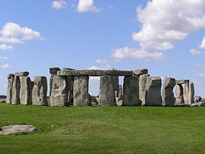
Before you read
Stonehenge on windswept Salisbury plain in southwest England exudes an air of mystery.

Slide 4
Start to read PP3-4
The earliest inhabitants (around 10000 years ago)
  The earliest inhabitants were the Stone Age hunters and gatherers who arrived from the European Continent.
The Neolithic peoples in Britain ( 8000B.C. --- 3500 B.C)
  They were settled agriculturalists who kept domestic animals and knew how to make simple pottery.
Stonehenge ( around 2000 BC --- 1500 BC)
  Stonehenge is a group of huge monuments of giant rock slabs on Salisbury Plain in Southwest England built by the Stone Age peoples. It is generally believed that Stonehenge served some sort of religious purposes.

Slide 5
Celtic peoples (around 700 BC)
  The Celtic peoples who had come from north-western Europe around 700 BC brought the skill of iron-working to Britain. By the time the Romans first landed in 55 BC, the Celtic culture was well established. They are ancestors of the Scots, Welsh and Irish people.
Romans invaded England in 55 BC (55 BC --- AD 411)
  The Romans first invaded Britain in 55 BC. They eventually conquered the various Celtic kingdoms then flourishing in England, Wales, and the Scottish Lowlands. The roman occupation lasted for about 350 years. They brought with them their laws, taxes, engineering skills, architecture and social system as well as their language, Latin, and their system of writing and numbering. They introduced Christianity. The earliest written records of Britain’s inhabitants came from the Romans.

Slide 6
The Scots

Slide 7
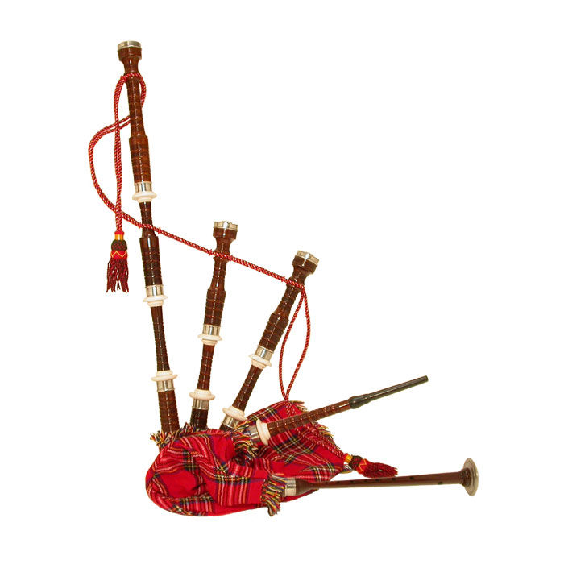
bagpipes
A musical instrument having a flexible bag inflated either by a tube with valves or by bellows.

Slide 8
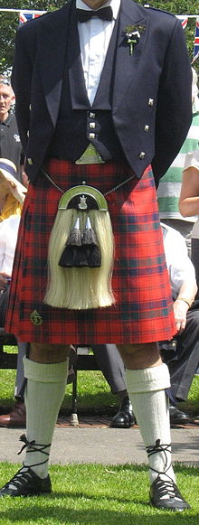
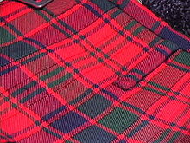
Kilt 苏格兰式短裙 — Tartan 格子呢

Slide 9

Scotch

Slide 10
Start to read
The earliest known ancestors of the Scots were the Picts and Celts. Their language was Gaelic.
They are classified into Highlanders and lowlanders. The highlanders mainly live by farming sheep in the mountain areas or fishing on the coasts and islands. But most Scots are Lowlanders who live in the industrialized urban areas of southern Scotland.
The Scottish Highlander considers himself the “true” Scot. His national dress is the kilt.
“Devils in skirts “ or “ladies from hell” are nicknames of the Scottish soldiers in the British Army. Over the centuries, enemy troops have often been terrified at the sight and sound of the bloodcurdling music of the bagpipes.

Slide 11

They are known for being inventive, hard-working, serious-minded and cautious with money.
Since the 1960s there has been considerable Scottish nationalist agitation for a separate parliament or assembly which would give the Scot a greater say in the planning and running of their own affairs. But the referendum held in Scotland by the British government in 1979 showed that only less than 40 percent of the vote was in favour of a separate Scottish assembly, so no further action was taken.

Slide 12
The Welsh

Slide 13
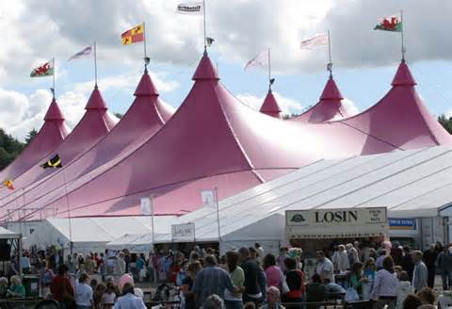
An eisteddfod is a traditional festival of poetry, music and dance conducted entirely in the Welsh language and is held every year in Wales.

Slide 14
The Welsh were united with England in 1535 by the 1535 Act of Union.
The Welsh are very conscious of their Celtic heritage. The cultural pride in Wales is very strong. The Welsh are also famous for their love of music and poetry. They also have a great feeling for the music of words.

Slide 15
The Welsh National Party, which has members in the Westminster Parliament, together with various pressure groups want more Welsh language and culture in school, the media and in public life generally.
The Welsh fall into groups: those --- mostly sheep farmers --- from the mountainous regions of the centre and north; and those who live and work highly industrialized south.

Slide 16
The two very different passions that have emerged from the hard-working lives of the Welsh people are rugby football and choral singing. The most famous festival of music and verse in Wales is the national Eisteddfod which takes place each August and lasts for about a week. The winner in the competition for the best epic poem about Wales written and read in Welsh is crowned Bard.

Slide 17
The Irish

Slide 18
Start to read
In the literary works of Irish people, the Irish are portrayed as introspective dreamers and poets, as well as argumentative and aggressive.
The whole of Ireland was colonized by England in 1169.

Slide 19
In the sixteenth century, the protestant reformation worsened the situation. The Irish refused to accept the Protestant reformation: they remained stubbornly true to their Catholic faith despite many cruel persecutions by the English.
Oliver Cromwell ( 1649 – 1660) crushed various rebellions in Ireland and settled English and Scottish Protestants there by giving them land. The main duty of the new immigrants was to put down any anti-British revolt by the native Irish.

Slide 20
Ireland was partitioned in 1922. the 26 counties of Southern Ireland became the Irish free state, later renamed the Republic of Eire. The six counties of Ulster in the north remained part of the United Kingdom with their own parliament, Stormont, responsible for internal affairs.

Slide 21
The Ulster Unionists refer to the ruling Protestant party in Northern Ireland. They are also called Loyalists. They remain loyal to the United Kingdom.
The Ulster Unionists, the ruling Protestant party, had complete control of Stormont, local councils, the police force and all public services. They did this by making sure that no Catholic could obtain a job in any public service; on all application forms, candidates were required to state their religion. Also it is easy to distinguish the Catholic Irish by their names.

Slide 22
The orange Day celebrations are celebrations held by protestants on 12 August each year in Northern Ireland to commemorate the Battle of the Royne in 1690 when the Protestant King William III (William of Orange) crushed a Catholic rebellion in Londonerry 1969.
IRA, the Irish Republican Army, is a nationalist organization dedicated to the unification of Ireland. It was organized in 1919. the IRA refused to accept a separate Northern Ireland under British rule. In 1969 it split into an “official” majority, which disclaimed violence, and a terrorist “provisional” wing, whose attacks on British troops in Northern Ireland, random bombings, and others acts of terror in England kept tensions high.

Slide 23
The Peace People
In the summer of 1976 Betty Williams, a Protestant housewife, was so horrified at the killing of two children by a running IRA car that she decided to organize women of Ulster, both Protestant and Catholic, into a pressure group working for peace and reconciliation.

Slide 24
The English

Slide 25
A traditionally typical Englishman is thought to be reserved, unemotional, courteous; shy of strangers; suspicious of change and slow to accept new ideas; solid and dependable with a high sense of honesty, duty and justice; physically and morally courageous; conscious of his place in the social order; disliking any show of emotion and lack of control; and fervently believing that the British are superior to any other race on earth. But English are as individual as the inhabitants of any other nation. Anyhow, they are descended from so many different peoples who came and settled in England in some time or other.

Slide 26
Angles, Saxons and Jutes (AD 450 --- AD 600)
Angles, Saxons and Jutes are Germanic tribes and they came from what is now Denmark and northern Germany.
The name England is, in fact, derived from Aengla-land.
Vikings (AD 800 --- AD 1000)
Viking raiders from Scandinavia plundered the coastland and islands but eventually they settled, intermarried and fused with the local population. During the ninth and tenth centuries, England was divided almost in half between the Viking Danes in the east and north east and the Saxons in the west. It was not until the end of the tenth century that the Saxons controlled most of the country.

Slide 27
The Norman Conquest ( AD 1066)
In AD 1066, William of Normandy landed his army in England, he defeated the Saxon king Harold and the English soldiers at the battle of Hastings, and became the king of England the same year. William of Normandy and his French-speaking followers set up a strong central government which brought a new unified discipline and control to England; the conquerors intermarried with the ruling Saxon families; they made French the official language; they firmly established the feudal system. Contacts between England and France were greatly increased. All in all, the French influence grew so strong that many aspects of England’s social and culture life became totally French.

Slide 28
England became a Protestant country in the sixteenth century. It became a refuge for other Protestants from Catholic states who were being persecuted for their faith.
One of the greatest migrations occurred in the 1930s and during the Second World War when thousands of people, especially Jews, fled from Nazi persecution in Germany, Austria, Czechoslovakia and other European countries.

Slide 29
Chapter 2
English History

Slide 30
Chapter goals
To know certain episodes and certain people from British history in different ages

Slide 31
The Middle Ages
The Sixteenth Century
The Seventeenth Century
The Eighteenth Century
The Nineteenth Century
The Twentieth Century

Slide 32
The Middle Ages
The medieval period in history was between the 5th and 15th centuries. Also called the Middle Ages, it was a time of change in western Europe. It began with the fall of the Roman Empire to invading Germanic tribes. Western Europe broke into many separate kingdoms. Trade collapsed; people made their living from the land; and the feudal system began. The early Middle Ages are called the “Dark Ages” because the learning and culture of ancient Greece and Rome almost disappeared. The medieval period ended when the Renaissance swept across Europe. English children are commonly told that the Middle Ages ended in 1485when the Wars of the Roses were over and the House of Tudor ascended the throne in the person of King Henry VII.

Slide 33
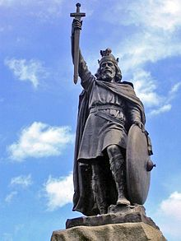
Alfred the Great was King of Wessex from 871 to 899.
Alfred successfully defended his kingdom against the Viking attempt at conquest, and by the time of his death had become the dominant ruler in England. He is the only English monarch to be accorded the epithet "the Great".

Slide 34
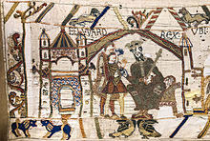
Which event is depicted in Bayeux tapestry?
Edward the Confessor sends Harold to Normandy

Slide 35
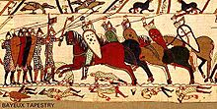
Battle of Hastings
It was fought on 14 October 1066 between the Norman-French army of William, the Duke of Normandy, and an English army under the Anglo-Saxon King Harold Godwinson, beginning the Norman conquest of England. It was a decisive Norman victory.

Slide 36
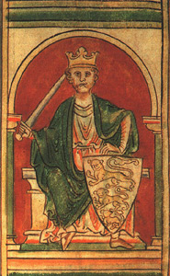
He was known as Richard the Lionheart, because of his reputation as a great military leader and warrior.

Slide 37
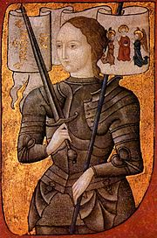
Who is she? Which war did she get involved in?
Joan of Arc was a French saint and national heroine. During the Hundred Years war, her bravery and inspiration provided spiritual and morale for French armies.

Slide 38
Start to read
King Arthur and his Knights of the Round Table King Arthur was the king of England in the sixth century. Little was known about him except that he was associated with Cornwall and is the central figure of many legends about him and his Knights of the Round table.

Slide 39
The story of King Arthur is one that has been told for hundreds of years. There have been poems, books and even films made of his life, all of them telling the story a little differently.
The basic story is this. There was a sword stuck in a stone. The legend said that whoever could remove the sword would become King of England and save the country. Many brave knights tried to pull the sword out, but they all failed. One day, a young boy called Arthur was walking past the stone. He didn't know it, but he was in fact the son of an old king. He pulled the sword out of the stone and became the new King of England.

Slide 40
The stories of Arthur as King are tales of bravery and nobility. His closest advisor was Merlin, a powerful wizard. Arthur lived in a castle called Camelot with his beautiful wife, Guinevere. In the castle he had a round table, where he sat with his knights. It was round so that there was no one at the head of the table (which is where the most important person would usually sit) and Arthur and his knights were all equal.

Slide 41
Alfred the Great He was a fine Saxon king who successfully defeated the invading Danes.
The Norman Conquest 1066

Slide 42
Norman Conquest
In AD 1066, William of Normandy landed his army in England, he defeated the Saxon king Harold and the English soldiers at the battle of Hastings, and became the king of England the same year. William of Normandy and his French-speaking followers set up a strong central government which brought a new unified discipline and control to England; the conquerors intermarried with the ruling Saxon families; they made French the official language; they firmly established the feudal system. Contacts between England and France were greatly increased. All in all, the French influence grew so strong that many aspects of England’s social and culture life became totally French.

Slide 43
The Crusades
The Crusades were a series of wars in the Middle Ages in which armies from all over Europe tried to snatch the “Holy Land” (i.e. Palestine, where Jesus Christ once lived) from the Infidels (i.e. the Muslims). The Norman King, Richard Lion-heart, was the most famous of the English Crusaders at that time. Many stories have been told about him and his enemy Saladin.

Slide 44
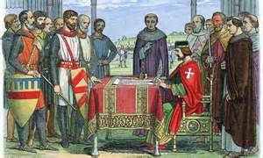
The Magna Carta (or Great Charter) was a document signed in 1215 by King John in order to make King John to recognize the rights of the barons.

Slide 45
One-hundred-year War (1337 – 1453) is a war between France and England which lasted, on and off, for a hundred years. The whole of France very nearly fell into English hands. However, partly through the inspiration of the brave girl Joan of Arc, and partly through the effective use of guns, the French drove the English from their country for good.

Slide 46
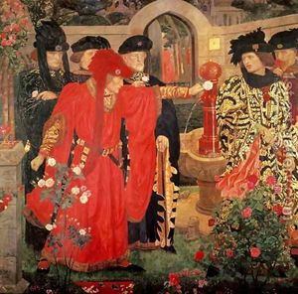
The Sixteenth Century
The Wars of the Roses

Slide 47
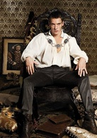
The Tudors chronicles the period of Henry VIII's reign in which his effectiveness as King is tested by international conflicts as well as political intrigue in his own court. What’s more, he is noted for his six marriages.

Slide 48
Start to read
The Wars of the Roses is the name given to the struggle (1455 – 1485) between two branches of the English royal family who each claimed the throne. Both branches, the houses of Lancaster, and the house of York took roses as their badges (red for Lancaster and white for York). The war weakened both the nobility and the monarch.

Slide 49
In the sixteenth century, the invention of printing made books much easier to produce and therefore much cheaper, so that ideas could spread quickly. It was the age of the great voyages of discovery and the beginning of the imperialist expansion, it was also the beginning of freedom of thought in the Christian religion.

Slide 50
The Catholic Church refers to the Christian church headed by the Pope. All members of the church accept the gospel of Christ and the teachings of the Bible. Any revolt against the traditional Christian faith was “heresy”.
The Protestant church refers to the Christian church whose faith and practice originated with the principles of the Reformation. Protestant churches sprang up in Northern Europe in opposition to the established Roman Catholic Church in the sixteenth century. In Britain, Protestantism gradually became the dominant faith in the Elizabethan age.

Slide 51
Henry VIII delivered the first blow to the Roman Catholic Church in England. The long quarrel between the Pope and Henry VIII on the matter of Henry VIII’s divorce ended in Henry VIII’s declaring that he and not the Pope was the head of the Church in England. As a result, the English Church broke away from the central organization of Christianity.
Bloody Mary was the nickname given to Mary I, Henry VIII’s elder daughter. She was a devout Catholic, and had so many Protestants burnt to death that she is remembered less by her official title Mary I than by her nickname Bloody Mary. She was succeeded by Elizabeth I. (refer to the movie Elizabeth I)

Slide 52
The Elizabethan age refers to the period during which Elizabeth I reigned in British history.
Elizabeth devoted to creating a strong united country in which there should be no more religious persecution and Protestantism gradually became the dominant faith.
It was an age of real literary achievement, especially that of Shakespeare (refer to chapter 6), and it was an age of adventure on the sea. For the first time English ships began to explore the world and trade with distant countries. They soon come into conflict with the might of Spain. Spain was the biggest enemy of England in the sixteenth century.

Slide 53
The Spanish Armada was a Spanish fleet to invade England. The strategic aim was to overthrow Queen Elizabeth I of England and the Tudor establishment of Protestantism in England. But it was a lucky victory for the English which marked the beginning of an English naval tradition which has never been forgotten.

Slide 54
The Gunpowder Plot refers to the most famous of a number of Catholic conspiracies in English history which occurred in the reign of James I. it was the plot to blow up the King and Parliament, in which a man called Guy Fawkes was caught in the cellars of t House of Commons in the very act of preparing the explosives. “Guy Fawkes’s Night” is still celebrated on November 5th each year.

Slide 55
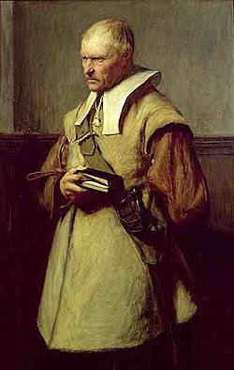
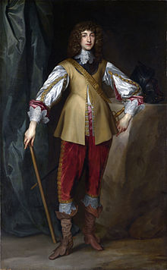
The Seventeenth Century幻灯片 79

Slide 56
The Seventeenth Century
King Charles I: an English king in the seventeenth century. He believed that he had a “Divine Right” to govern. For a time, Charles actually ruled without parliament, and levied taxes without Parliament’s approval. This aroused the opposition of the “roundheads”, and the great Civil War broke out.

Slide 57
The English Civil War: it is a bitter power struggle (1642-1648) between the monarchy and Parliament. The victory of the Parliament led to the execution (1649) of Charles I and the temporary overthrow of the monarchy. (refer to A History of Britain : 8)
Oliver Cromwell: he was the Roundhead leader during the English Civil War. He defeated King Charles I and condemned him to death. The monarchy was overthrown and the country became for more than ten years a republic.

Slide 58
The “Roundheads”(圆颅派或平头派） were the nickname of the “Puritan” elements, those with very strict Protestant principles. They were supporters of the Parliament. They were nicknamed the “Roundheads” because of the bare look of their shorn heads contrast with the long, curly wigs of the King’s more fashionable supporters, the “Cavaliers” （骑士派）.

Slide 59
The Glorious or Bloodless Revolution refers to the event of 1688 in the English Revolution when the Catholic king James II was forced to flee with his baby son to death. The throne was offered to his Protestant daughter Mary and her husband William. The bill of Rights was passed by Parliament to restrict the power of the Monarchy. This was the beginning of the Constitutional Monarchy in Britain.

Slide 60
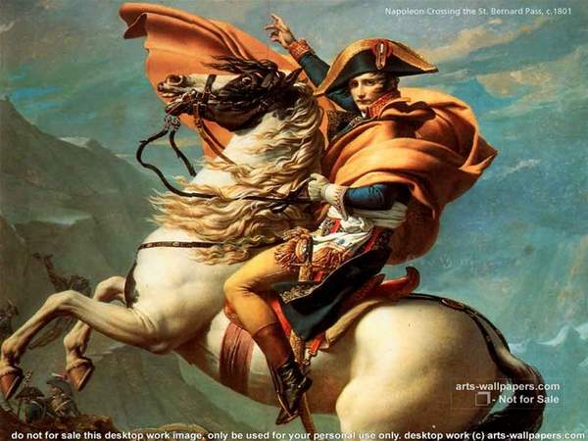
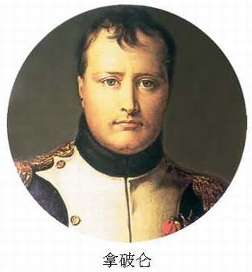
The Eighteenth Century

Slide 61
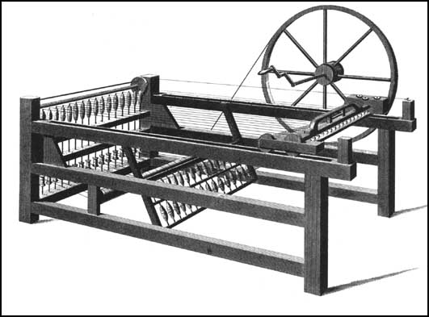
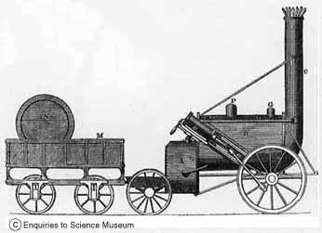
Spinning Jenny/locomotive

Slide 62
The Eighteenth Century
Britain’s great enemy during the whole of the eighteenth century was France.
The two most famous victories were the Battle of Waterloo, won by the Duke of Wellington over the great Napoleon and the battle of Trafalgar won by Lord Nelson over Napoleon’s fleet.

Slide 63
The Industrial revolution refers to the period in British history from 1750 to1850. Great changes took place with the invention of the steam engine. More factories and big towns were built. It made Britain stronger and richer, and at the same time it also created an entirely new social class, the industrial workers.

Slide 64
The loss of American colonies: a group of Puritans had sailed from England in the ship Mayflower to escape religious persecution under James I; they settled in various parts of North America’s Atlantic coast. Trouble arose when the settlers refused to pay taxes to the British government. By the declaration of Independence, the settlers renounced their British citizenship and became Americans.

Slide 66
The Nineteenth Century
The main historical interest lies in the efforts made to (a) to overcome social problems, (b) to make Parliament more representative of the people, and (c) to improve local government and social services.

Slide 67
Policemen are called “Peelers”, or rather affectionately “bobbies” because of Sir Robert (Bobby) Peel, who founded the modern police force of Britain.
A start was made in extending the ‘franchise’.

Slide 68
The Victorian age refers to the monarch of Britain under the great Queen Victoria from 1837 to 1901. The Victorian age was an age of national development and national development and national optimism. The Victorians were very religious and conservative in family life. It was also, in its later stages, an age of imperialism.

Slide 69
The Twentieth Century
The Victorian stability collapsed within a few years of the death Queen Victoria. The working classes rose up to fight for their rights and the women woke up to fight for the right vote. Meanwhile the trouble in Ireland was going from bad to worse.

Slide 70
Britain became involved in World War I because she had made friends with her old enemy, France, who was being attacked by Germany. The world seemed very difficult at the close of the war.
The franchise was extended to virtually all adults.
The Southern part of Ireland became completely independent.

Slide 71
The General Strike in 1926 and the great “slump” of the early 1930s became the two most disastrous events in Britain.
It was Hitler’s constant thirst for power that led Europe into the Second world war.

Slide 72
